Slide 1
Creating Employee performance scorecard in Excel
PRESENTED BY: MADHUMITHA S
REGISTER NO:312209099 asunm1353312209099
DEPARTMENT:COMMERCE
COLLEGE: ANNA ADARSH COLLEGE FOR WOMEN

Slide 2
PROJECT TITLE
Creating an Employee Performance Scorecard in Excel

Slide 3


AGENDA
Problem Statement
Project Overview
End Users
Our Solution and Proposition
Dataset Description
Modelling Approach
Results and Discussion
Conclusion
3/21/2024 Annual Review

Slide 4

PROBLEM STATEMENT
To Develop an Excel-based Employee Performance Scorecard to systematically evaluate and monitor employee performance across multiple criteria.
The scorecard should facilitate performance reviews, goal setting, and improvement tracking.

Slide 5

PROJECT OVERVIEW
.
An employee performance scorecard in Excel is a tool used to systematically evaluate and track an employee's performance against predefined objectives and key performance indicators (KPIs).
It typically includes various metrics such as productivity, quality of work, punctuality, teamwork, and any other relevant criteria.

Slide 6

WHO ARE THE END USERS?
HR PROFESSIONALS
MANAGER
SUPERVISORS
EXECUTIVE
EMPLOYEES

Slide 7

OUR SOLUTION AND ITS VALUE PROPOSITION
CONDITIONAL FORMATING – EDITING BLANKS MARK
FILTERING – REMOVING MISSING VALUES
USING PIVOT TABLE – SUMMARY OF EMPLOYEE PERFORMANCES
FORMULA - =IFS FORMULA
USING SLICER – EMPLOYEE TYPE
GRAPHS = FINAL REPORT

Slide 8
Dataset Description
Kaggle is a platform that hosts a wide variety of datasets across different domains. A dataset description on Kaggle typically includes the following elements
Title and Overview: A brief description of the dataset and its purpose
Content and Structure: Information about the dataset's contents, including the number and types of files, data columns, and data type .
Source and Licensing: Details about the origin of the dataset and any licensing or usage restrictions.

Slide 9

THE "WOW" IN OUR SOLUTION
The dataset for the Performance Management Dashboard is designed to capture and analyze key aspects of employee performance. It consists of multiple data fields that provide a comprehensive view of each employee's performance metrics. Here's a detailed description of the dataset structure and the significance of each data field:
Dynamic Data Summarization
Interactive Data Exploration
Customizable Views and Reports
Trend Analysis and Comparison
Visual Data Representation
Efficient Data Management
Advanced Filtering and Grouping
3/21/2024 Annual Review
9

Slide 10
MODELLING
STEP 1 : DATASET FEATURE SELECTION – EMPLOYEE ID , FIRST NAME,BUSINESS UNIT, GENDER,EXPIRE DATE, PERFORMANCES SCORE, EMPLOYEE TYPE.
STEP 2 : DATA CLEANING : PERFORMANCE CATEGORY COMPUTATION USING FORMULA : =IFS(Z8>=5,”VERY HIGH”,Z8>=4,”HIGH”.Z8>=3.”MED”.”TRUE,”LOW”)
STEP 3 : PERFORMANCES SUMMARY PIVOT TABLE ( BUSINESS UNIT ROWS ,GENDER FILTER
10

Slide 11
MODELLING
STEP 4 : SLICER FOR EMPLOYEE TYPE
STEP 5 : GRAPH – COLUMN CHART FOR MALE , FEMALE, EMPLOYEE
STEP 6 : EDITING FOR + ICON IN CHART TO CUSTOMIZES
AXIS TITLE
ASES
CHART TITLE
GRIDLINES
11

Slide 12
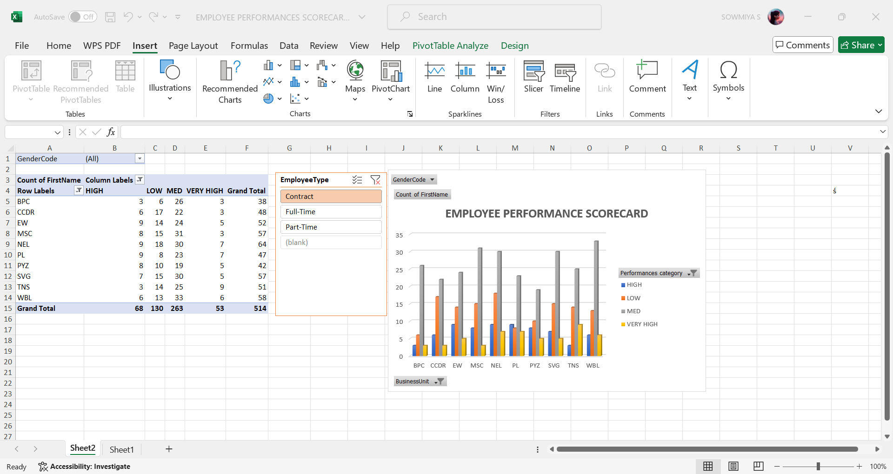
RESULTS
12

Slide 13
conclusion
The Employee Performance Scorecard effectively tracks and evaluates key performance indicators (KPIs) across various department .
Insights from the scorecard highlight areas of strength and opportunities for improvement, enabling more targeted management strategies

